Slide 1
Defect Detection And Packing Using Conveyor Belt
Subject Code :- MTR-401
Session : Jul – Dec 2021
Presented By :- Project Supervisor :-
Jayanth – 18BEM1027
Garima Itten – 18BEM1051
Raghavnedra – 18BEM1050
Adeel – 18BEM1059
Mr. Inderpreet
Mechatronics Department

Slide 2
Contents
Introduction
Literature Review
Review Analysis and Research Gap
Project Objectives and Details
Experimental Setup/Procedure
Work Plan or Division/Timeline (By Each Team Member)
References

Slide 3
Introduction
There are different types of industries doing many different productions, but in every industry after production industry needs to check every product produced is not damaged/Not Perfect as it should be.
If the damaged product is out of production line and packed and sent to sales the customers who buy damaged goods will loose trust on company and hence not good for companies future
In order to avoid these circumstances all the industries use the final checking section of Defect Detection before it Is packed and set out for sales
In this project we are going to show the model of the defect detection it working same as in industries and also packing system of the final approved product
There are different types of defect detection according to the different items made in industries each product has its own method of detecting the damage/flaws after production
In our project we are going to use the camera and we detect the damage of product by analyzing the image and then detect the flaws in product if any of the product have damage/flaw in production then a robotic arm will take the damaged product out of the production line and separate them & then sent further packing.

Slide 4
Literature Review
Sr.No | Author(s) | Type/Title of study
1] | H. Schweitzer, W.B. James, and W. Feng | "Very fast template matching."
2] | H. Zhang, S. Shen, and I.A. McAllister | "Camera blemish defects detection."
3] | M.S. Kim | "Lens shading correction device and method in image sensor."
4] | D.Y. Kim, Y.H. Noh | "Method and apparatus for compensating image sensor lens shading."
5] | CW. Huang, | "System and method for detecting defects in camera modules."

Slide 5
Research Gap
We Are making the model of how an industry level Defect Detection System Works, This Model Contains After Production Of The Product How an defect product would be suppurated from the Production & Packing Line And Then After taking out the defect product model shows us how the packing process happens.
Most of the models and projects we encountered on our research were only packing systems and defect detection systems were all industry level and using high end components in our project we integrated the same features By using Machine learning we train the ESP-32 Module to detect Defect in the product and when ESP-32 identifies the defect product it is taken out from conveyor belt using servo motor.
Other projects we have found out are not using Machine Learning On their System Few are using just laser
Our model can run as precise it gets and it depends on how much input we have given to train the model for detecting good & damaged product using EDGE IMPULSE
Our Model Also Has packing system included in production line to show packing Is done

Slide 6
Objectives & Details
To design a working model of Defect Detection System using ESP-32 Module.
Using Deep Learning to Achieve the goal integrated to ESP-32 Module for better detection of defects in production line.
Training the model to detect & classify the product by taking image and processing it to conclude whether the product is Damaged Or Good for packing.
Get A better understanding of how Machine Learning works in real life & how we can improve our skills in by using Platforms Like EDGE IMPULSE for better understanding
To Design a project in which require Skills Of Coding ML & Skill to create a mechatronic system by combining them both into one piece and making it a system

Slide 7
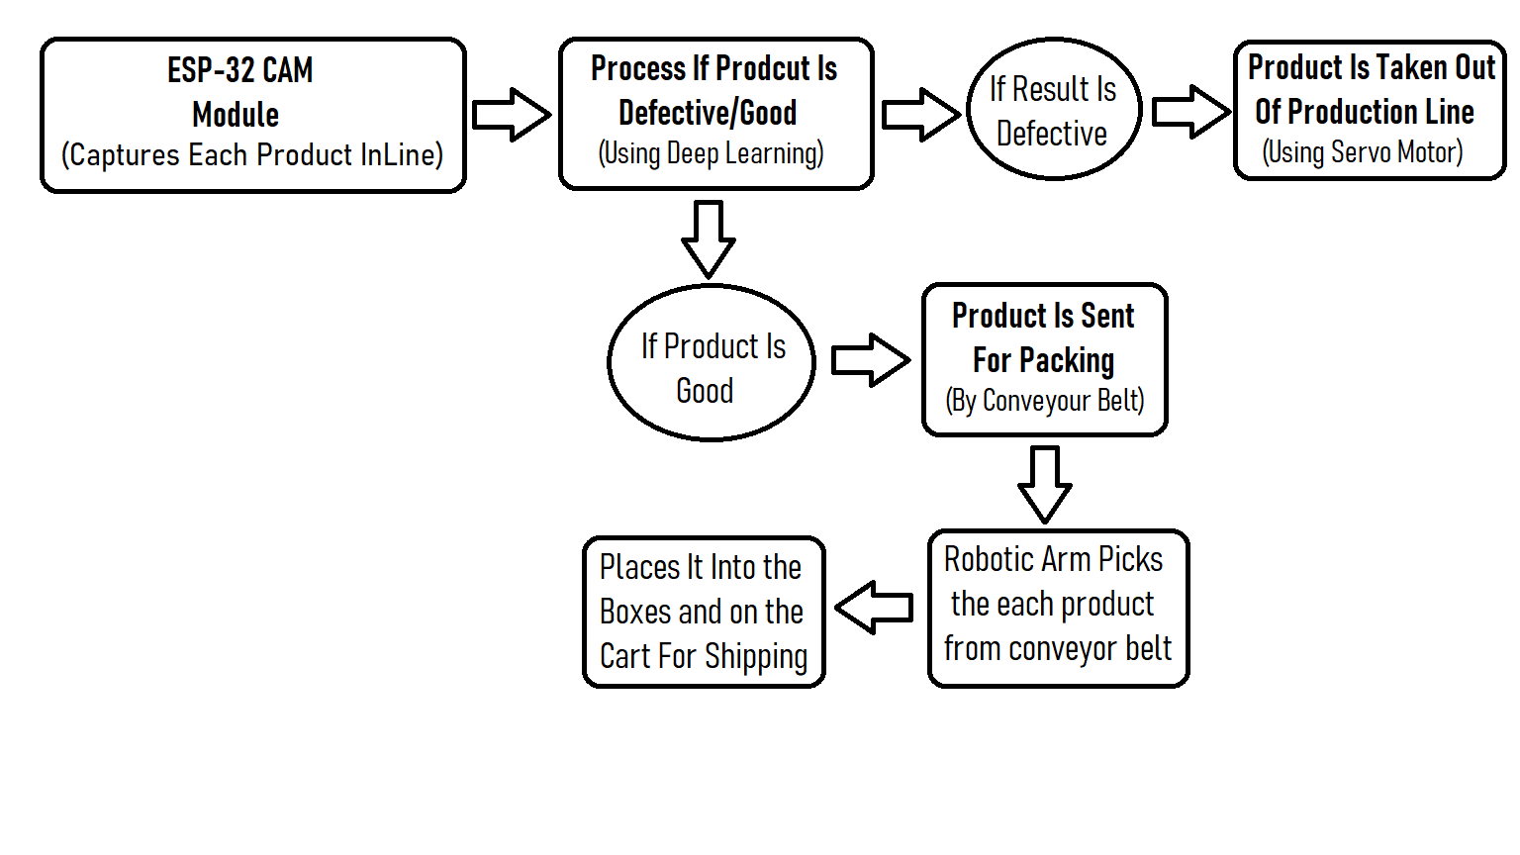
Experimental Setup
Block Diagram :-

Slide 8
Components
Sr.No | Component Name
1. | ESP-32 CAM Module
2. | TCRT5000 IR Sensor
3. | Servo Motor
4. | L293D Motor Driver
5. | DC Motor
6. | Connecting Wires & Others

Slide 9
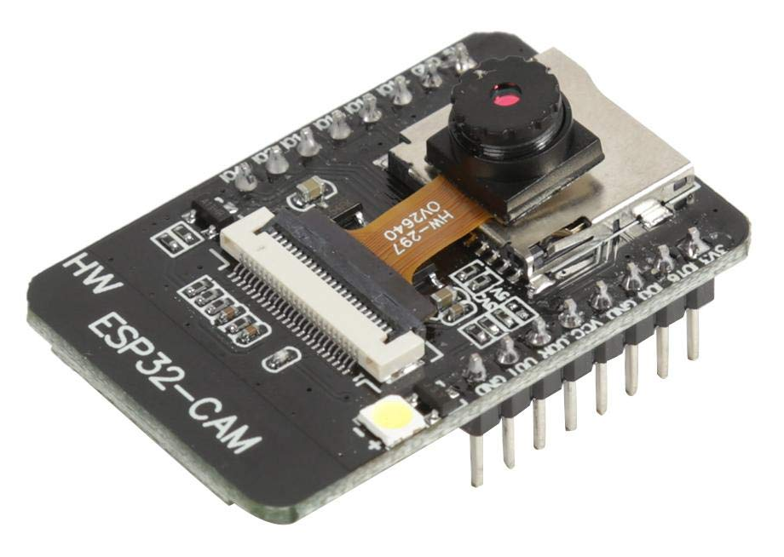
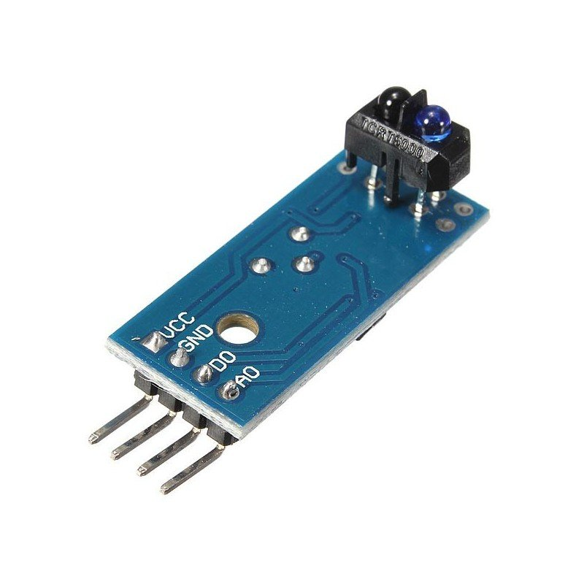
Components
ESP 32-CAM :
Module model: ESP32-CAM Bluetooth + WiFi Input Voltage – 5v
Bluetooth: Bluetooth 4.2 BR/EDR and BLE standards Wi-Fi: 802.11 b/g/n/e/i Support interfaces: UART, SPI, I2C, PWM
This will be set-up on bike so that rear view of bike will be transmitted & seen through helmet directly
TCRT5000 :- The TCRT5000 is an IR sensor unit. It has both a Photodiode and a Phototransistor coupled in its packageThis sensor can be used to detect the presence of object or any other reflective surface in front it, also with some level of programming it can also calculate the distance of the object in front it. It runs on 3.3v input voltage

Slide 10
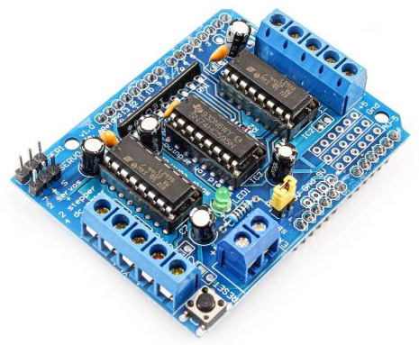
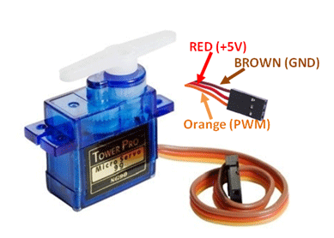
Components
L293D Motor Driver :
L293D IC is a typical Motor Driver IC which allows the DC motor to drive on any direction. This IC consists of 16-pins which are used to control a set of two DC motors instantaneously in any direction. It means, by using a L293D IC we can control two DC motors. As well, this IC can drive small and quiet big motors.
Servo Motor :
Micro Servo Motor SG90 is a tiny and lightweight server motor with high output power. Servo can rotate approximately 180 degrees (90 in each direction), and works just like the standard kinds but smaller. You can use any servo code, hardware or library to control these servos.

Slide 11
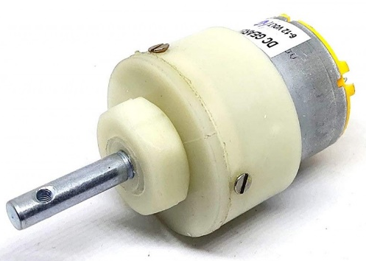
Components
DC Motor :-
A direct current (DC) motor is a type of electric machine that converts electrical energy into mechanical energy. DC motors take electrical power through direct current, and convert this energy into mechanical rotation. The output torque and speed depends upon both the electrical input and the design of the motor.

Slide 12
Work Plan
Days | Work Done | Work Place
1-3 | Problem Identification & Selection | Home, Web
4-7 | Designing , Listing Components & Placing Order | Home
8-10 | Testing Working Of Components | Home
10-17 | Preparing Coding & Testing Work | Home
18-22 | Clearing Errors & Solving Problems | Home, Web
23-26 | Redesigning & Checking Requirements | Home
 | Final Project

Slide 13
References
1. H. Schweitzer, W.B. James, and W. Feng, "Very fast template matching." European Conference on Computer Vision. Springer, Berlin, Heidelberg, 2002.
2. H. Zhang, S. Shen, and I.A. McAllister, "Camera blemish defects detection." U.S. Patent No. 8,797,429. 5 Aug. 2014.
3. M.S. Kim, "Lens shading correction device and method in image sensor." U.S. Patent No. 7,834,925. 16 Nov. 2010.
4. D.Y. Kim, Y.H. Noh, "Method and apparatus for compensating image sensor lens shading." U.S. Patent No. 8,023,014. 20 Sep. 2011.
5. CW. Huang, "System and method for detecting defects in camera modules." U.S. Patent No. 7,974,458. 5 Jul. 2011.
6. R. Mehrotra, K.R. Namuduri, and N Ranganathan. "Gabor filter-based edge detection." Pattern recognition, p.1479-1494, December 1992.
7. Y. Sun, X. Li and J. Xiao, "A cascaded mura defect detection method based on mean shift and level set algorithm for active-matrix OLED display panel", J. Soc. Inf. Display, vol. 27, no. 1, pp. 13-20, Jan. 2019.
8. Y. Wang and D. D. L. Chung, "Capacitance-based defect detection and defect location determination for cement-based material", Mater. Struct., vol. 50, no. 6, Dec. 2017.
9. C.-H. Chan and G. K. H. Pang, "Fabric defect detection by Fourier analysis", IEEE Trans. Ind. Appl., vol. 36, no. 5, pp. 1267-1276, 2000.
10.L. H. Siew, R. M. Hodgson and E. J. Wood, "Texture measures for carpet wear assessment", IEEE Trans. Pattern Anal. Mach. Intell., vol. 10, no. 1, pp. 92-105, Jan. 1988.
11.D. L. Yuan, L. P. Lu and Y. M. Song, "Recent studies on automatic fabric defect detection technique", J. Zhengzhou Inst. Light Ind., vol. 20, no. 3, pp. 69-73, 2005.
12.Mr. Shete Yogesh Shreekrushna ,“Fabrication of Faulty Product Detection and Separation System”, RST Pvt. Ltd., Akluj.PaperID: IJSRDV8I60043,Published in: Volume:8,Issue:6,PublicationDate: 01/09/2020,Page(s): 25-30

Slide 14
Thank You !
The END

